Slide 1
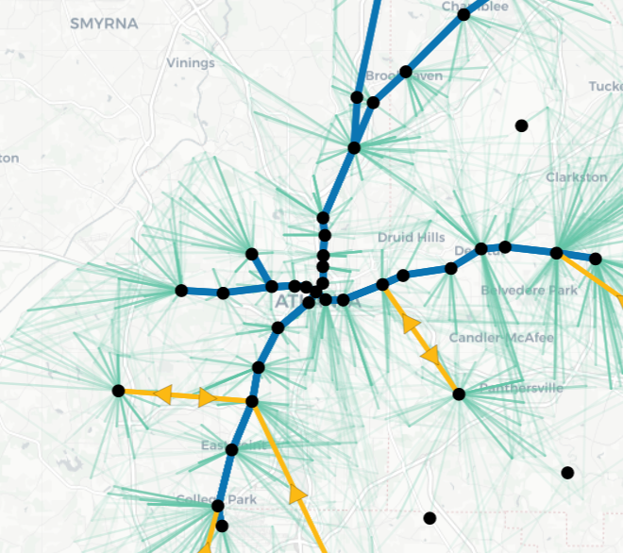
Week 1 Plan
Region 1
Identify potential hubs using DBSCAN
Split potential hubs into different regions
Simple variant of Plan b (don’t fix anything in the current network design)
Consider a region
Add potential hubs of this region to the current set of hubs
Solve the network design problem
Potential hubs selected by the design become “small hub set candidates”
Remove all hubs added and consider another region until City of Atlanta is covered
Solve the global network design problem with all small hub set candidates
Do we really see improvement?

Slide 2
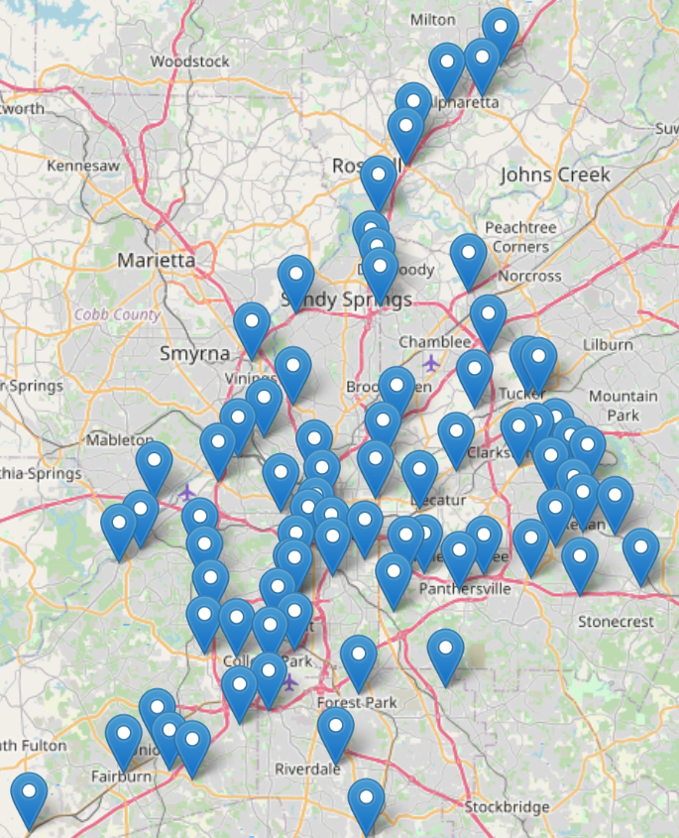
Week 1 Progress
1 | 2 | 3 | 4
5 | 6 | 7 | 8
9 | 10 | 11 | 12
13 | 14 | 15 | 16
Split potential hubs into different regions
75 potential hubs
16 regions
Regions with no hub?
They are empty for now due to MARTA data
Will be updated once using large ARC data
Let network design select small hub candidates
Region by region
Narrowed down to 19 potential hubs
Let network design select final candidates
global
8 selected (see next slide)

Slide 3
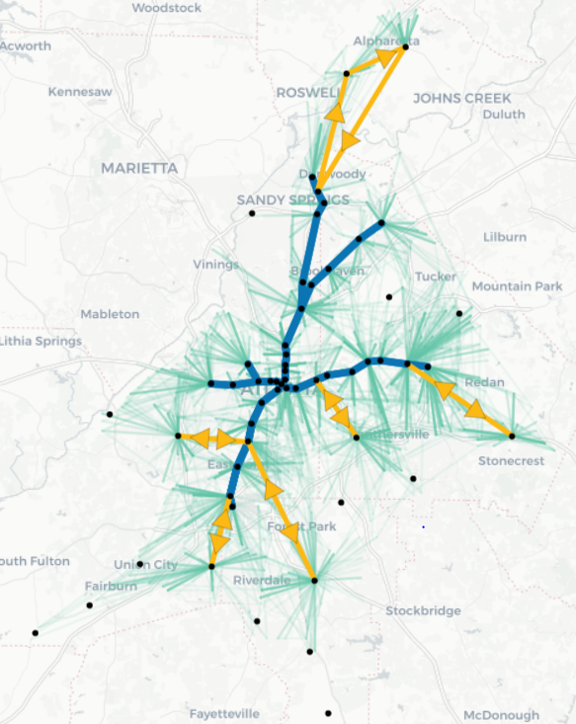
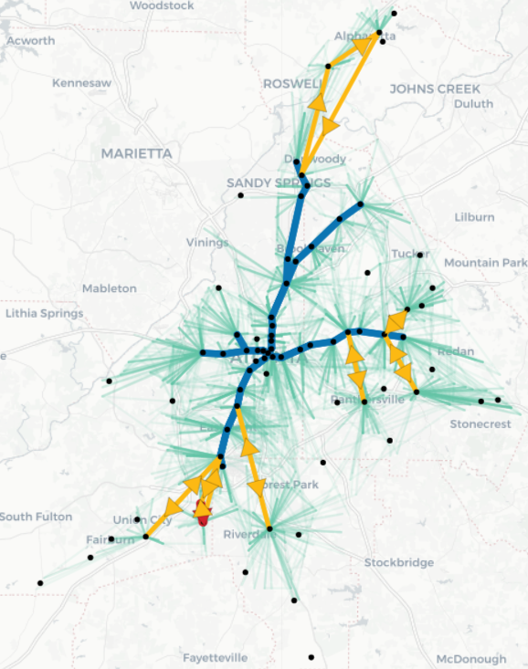
Old vs. New

Slide 4
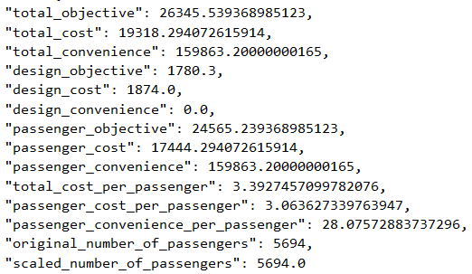
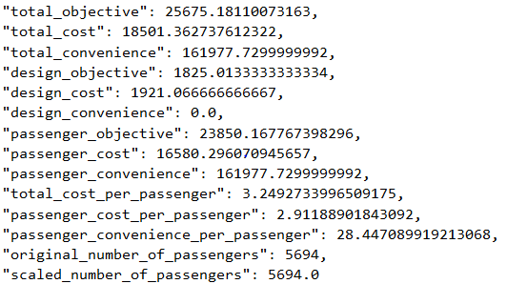
Old vs. New
2.5%
4.2%
1.3%
2.5%
2.5%
2.9%
5.0%
1.3%
4.1%
4.9%
1.3%

Slide 5
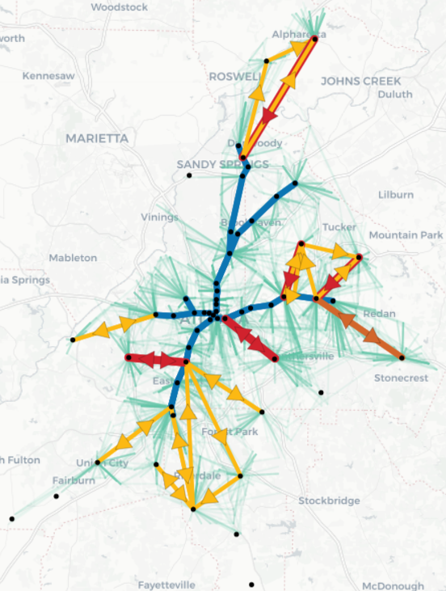
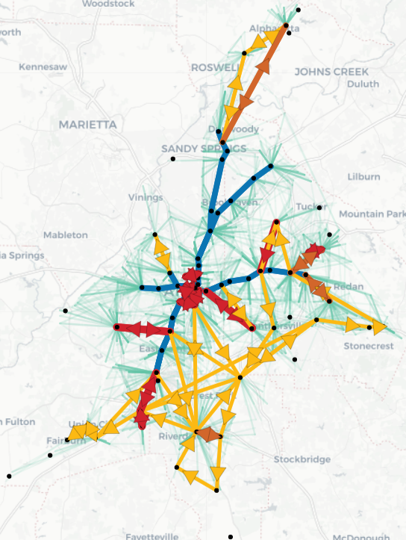
Old vs. New (passenger factor 5)

Slide 6
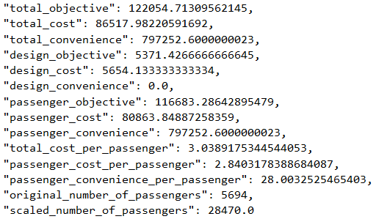
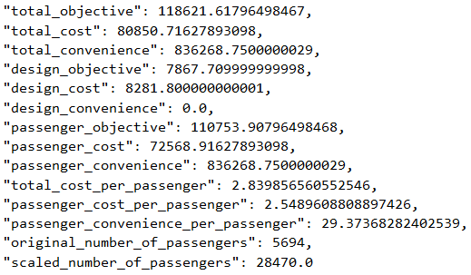
Old vs. New (passenger factor 5)
2.8%
6.6%
4.9%
46.5%
46.5%
5.1%
10.3%
4.9%
4.1%
6.6%
4.9%

